Slide 1
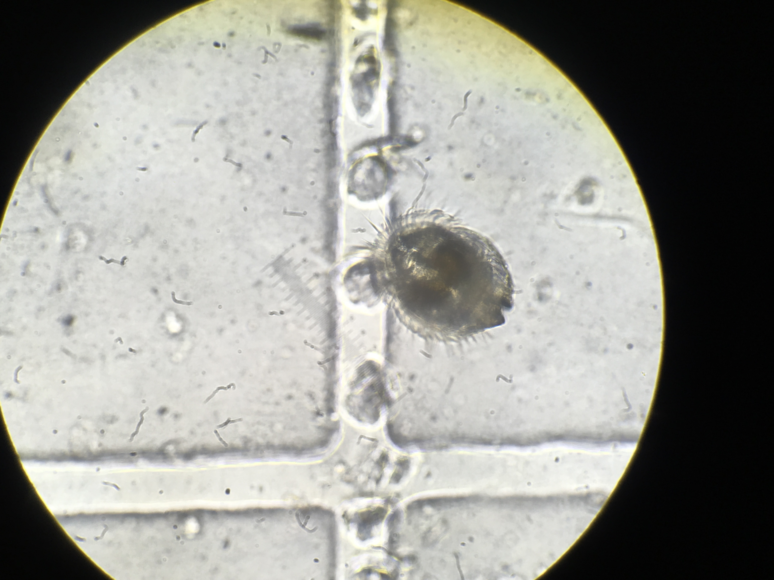
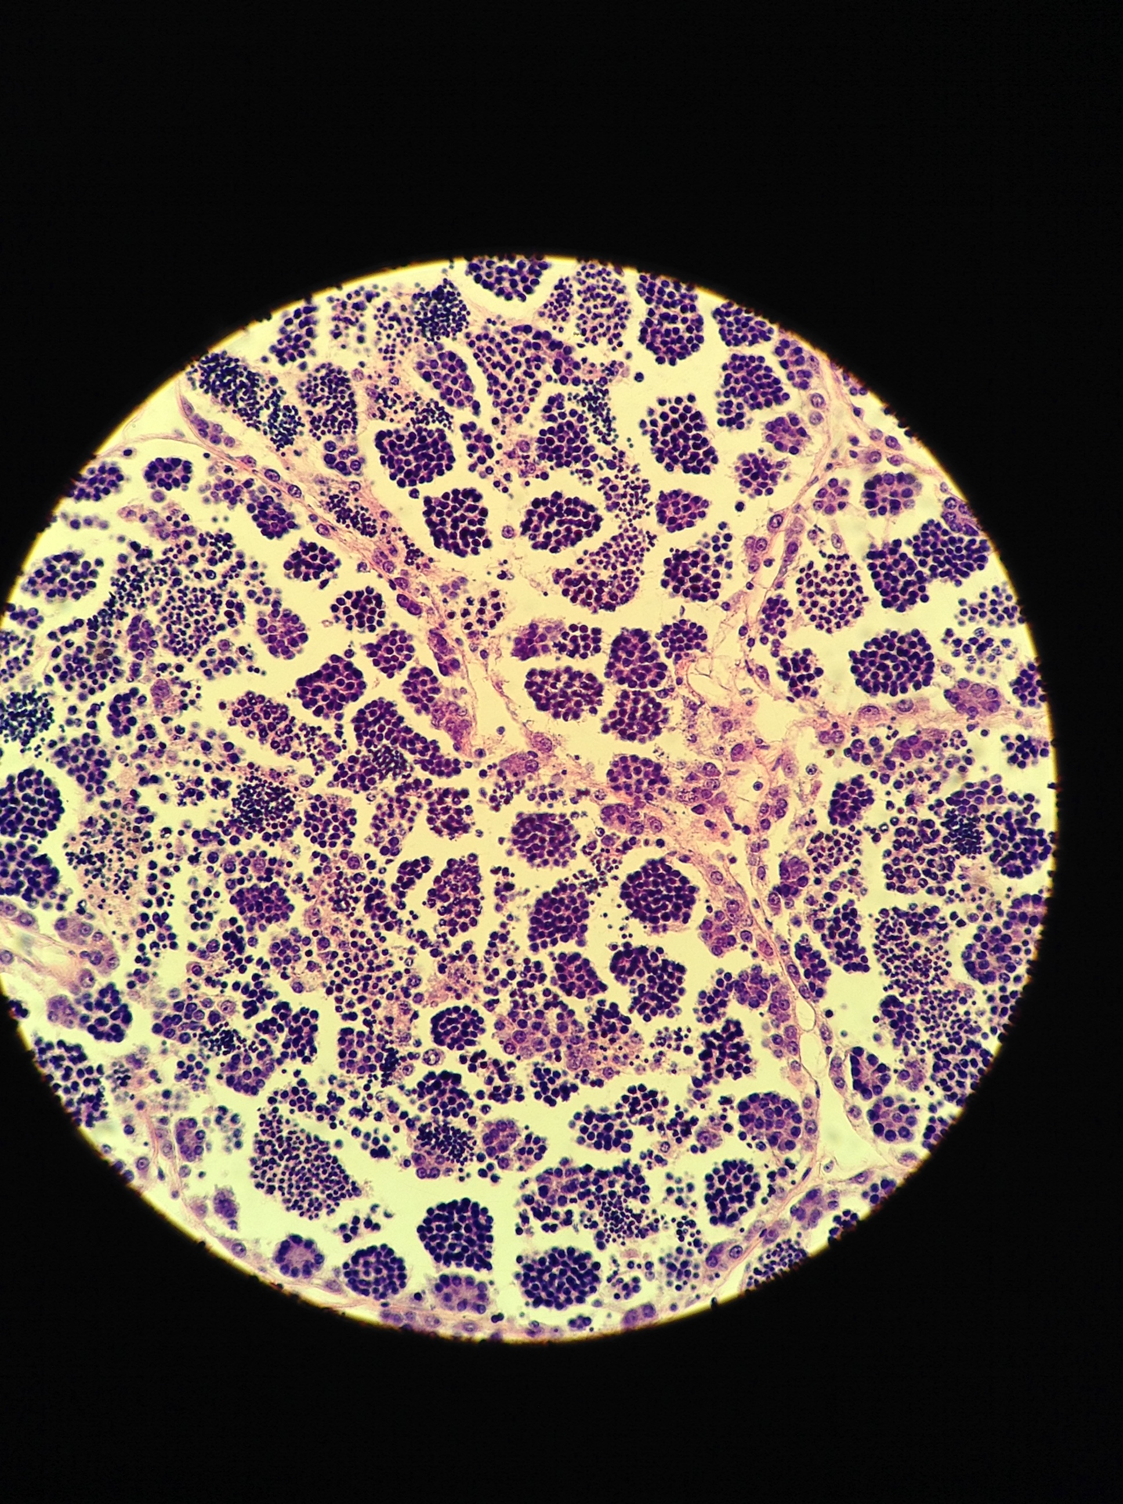
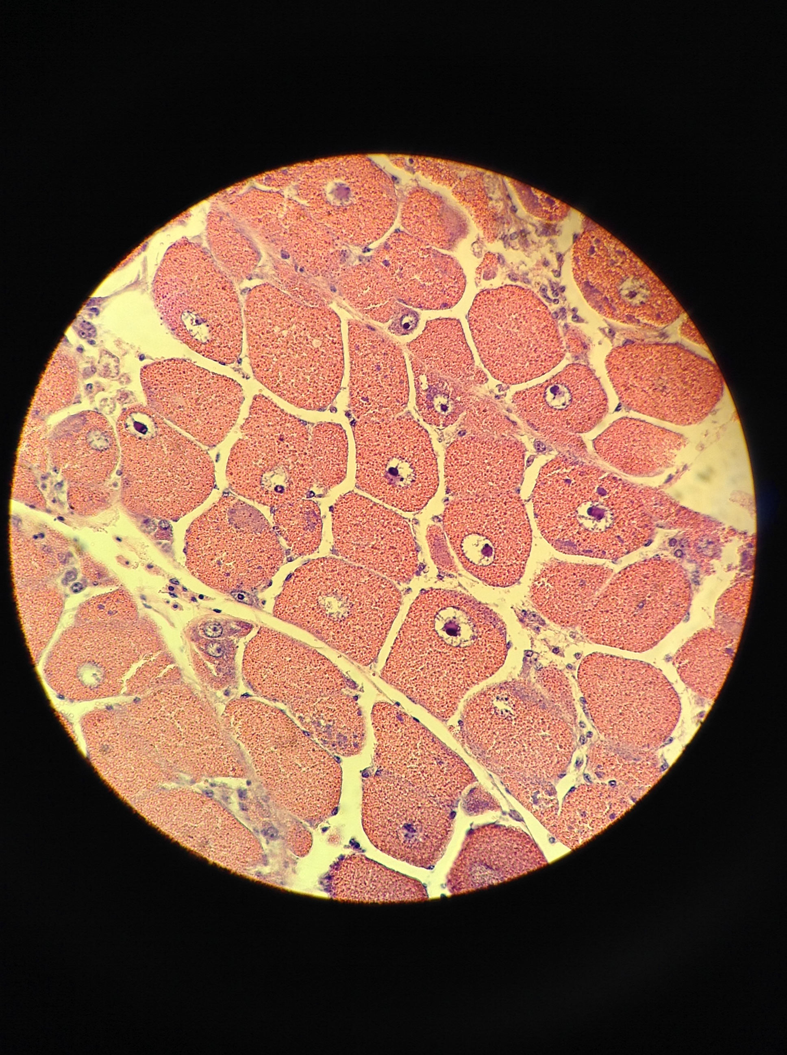
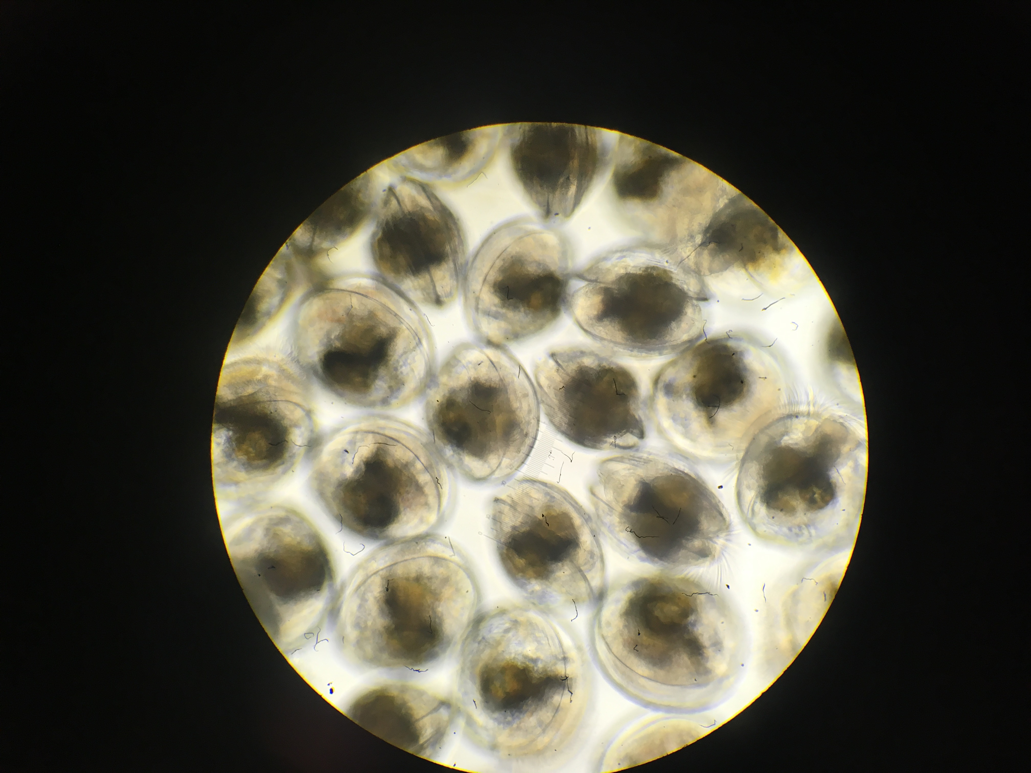
Olympia oyster questions
1. Does/how does low pH exposure affect gonad tissue gene expression?
2. Does parental low pH exposure affect offspring gene expression (larvae)
→ Important: larvae not exposed to different pH or environments

Slide 2
Goal: denovo assembled reference transcriptome
RNASeq data from gonad tissue
4 individuals pooled
Quality check: FastQC
Goal: count matrix from RNA, 24 samples
QuantSeq data from gonad tissue and larvae (whole body)
Clean data: FASTX Toolkit
Trim adaptors, deduplicate, quality filter (90% bases >20 score)
Trinity Assembly on Mox
Includes Trimmomatic
Quality check: Transrate
Annotate: blast
Derive pseudo-counts: Kallisto
(used script within Trinity)
Create collapsed transcriptome to remove isoforms: cd-hit
My bioinformatics workflow

Slide 3
Goal: Differential Gene Expression analysis
Count matrix from Kallisto
DESeq in RStudio/Markdown
Sample quality check: Heat map, initial PCA, total counts
DESeq:
Compares log2-fold change for each gene between treatments
Transform data for PCA
(reduce heteroskedasticity)
PCA analysis, visualize
Data analysis workflow
Gonad and larval samples run in parallel

Slide 4
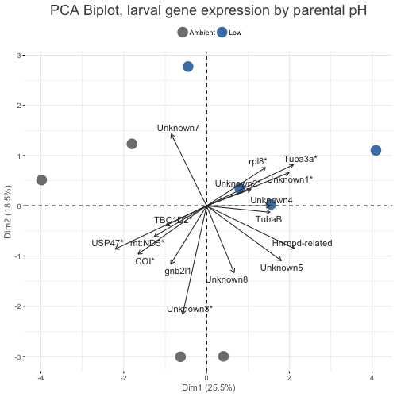
Larval sample results
COI: Cytochrome c oxidase, aerobic respiration
mt:ND5: NADH-ubiquinone oxidoreductase, mitochondrial electron transport
USP47: Ubiquitin component, DNA repair
TBC1D2: protein transport, GTPase activity
Tuba3a: Tubulin, cytoskeleton
Rpl8: ribosomal protein, cytoplasmic translation

Slide 5
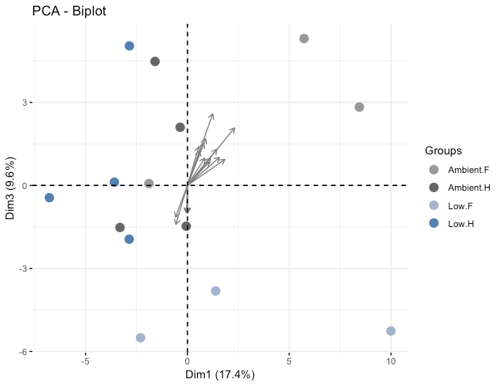
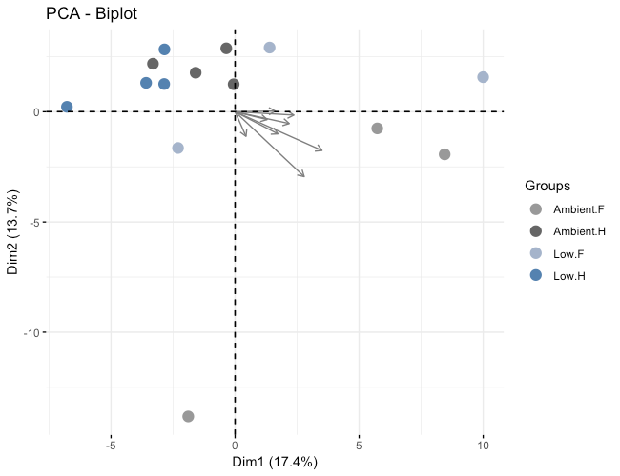
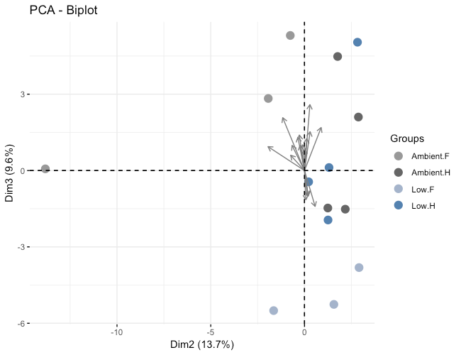

Slide 6
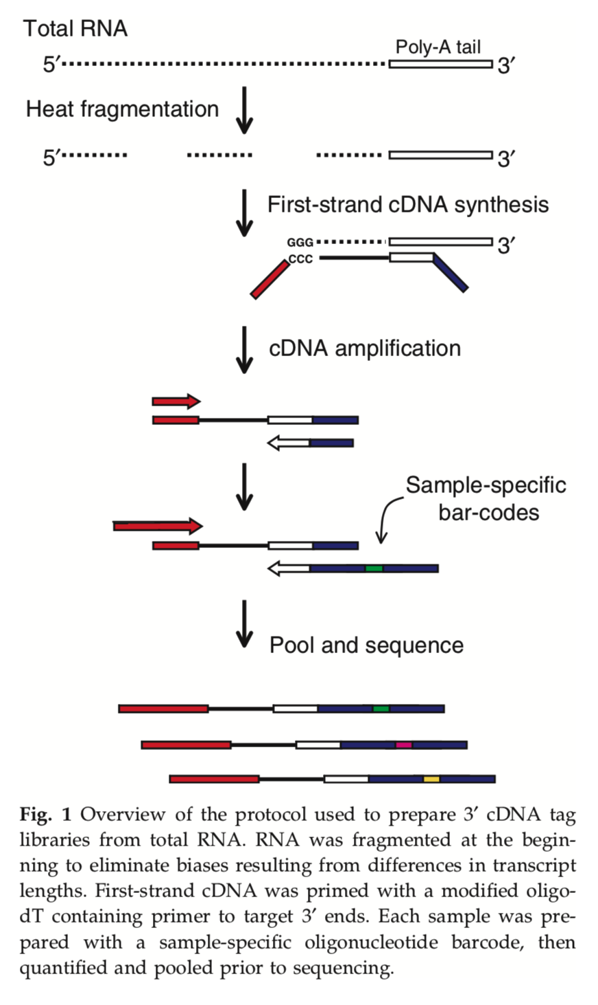
QuantSeq / TagSeq Library Prep

